Slide 1
Comparing Open Source CMSs: Joomla, Drupal, and Plone
Nonprofit Technology Conference
April 2007

Slide 2
What We’ll Cover
Intro to Open Source Content Management Systems
Comparing Joomla, Drupal, and Plone
Joomla Demo
Drupal Demo
Plone Demo
Q & A

Slide 3
Introductions
Laura Quinn, Idealware
Ryan Ozimek, PICnet
David Geilhufe, CivicSpace
Patrick Shaw, NPower Seattle
What are you hoping to get out this session?

Slide 4
An Introduction to Open Source Content Management Systems

Slide 5
What Does it Mean to Be Open Source?
Open Source (OS) applications….
Allow you to access and change the source code
Often can be downloaded without cost
Typically require at least some tech-savvy to get up and running
Are supported by a community of users and consultants
Often offer many “plug-ins” created by the community

Slide 6
What is a Content Management System?
An OS content management system (CMS) allows you to manage website text and images through a database. This typically means…
Quicker website setup
Completely flexible graphic design
Tools to easily update pages and navigation
Support for rule-based content (like events or news)
Community support and plug-ins

Slide 7
What is a CMS: Setting up a Website
CMSs make it easier to create a website than building it from scratch.
You download the CMS code and install it on a web-server
Basic setup is done through forms, without code
CMSs encourages web standards, like accessibility
Ease and tech skills required depend on the CMS
If you have unusual needs, you can extend through code (consider the coding language)

Slide 8
What is a CMS: Tailoring the Graphics
All three of these tools allow completely flexible graphic design.
Can use a default look, but they’re quite generic
A design starts with a graphic designer
Designs are implemented through HTML and CSS

Slide 9
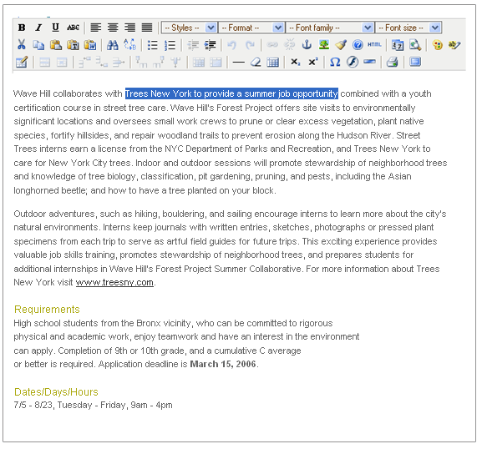

What is a CMS: Updating Pages and Navs
CMSs allow easy update of pages and navigation

Slide 10
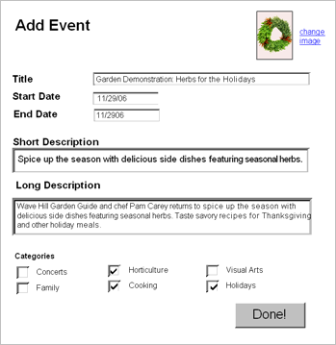
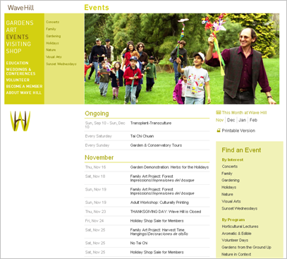
What is a CMS: Rule Based Content
Many CMSs can also automatically display items like events or news based on rules

Slide 11
What is a CMS: Community Support
These tools are supported by a community.
There is a core base of developers who organize updates
The community also builds and shares extensions and plug-ins
You can talk to other users and experts in forums
Consultants specialize in developing and supporting using these tools

Slide 12
Comparing Joomla, Drupal and Plone

Slide 13

Joomla
www.womensedge.org

Slide 14
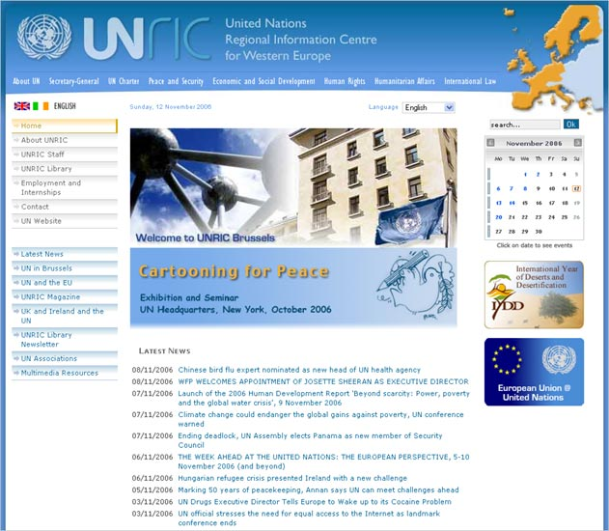
Joomla
www.unric.org

Slide 15
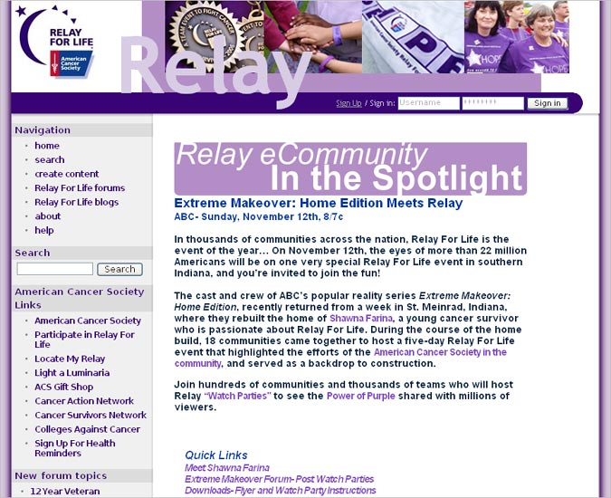
Drupal
www.relayforlife.org

Slide 16
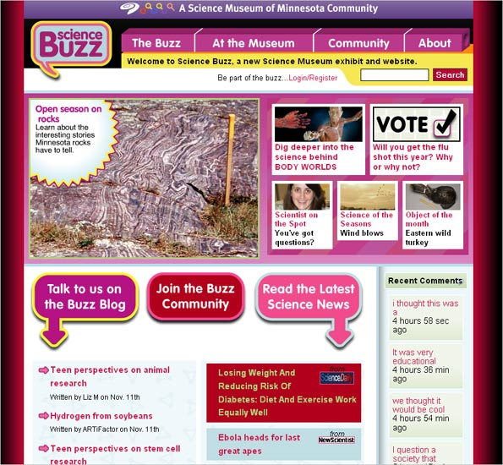
Drupal
http://buzz.smm.org

Slide 17
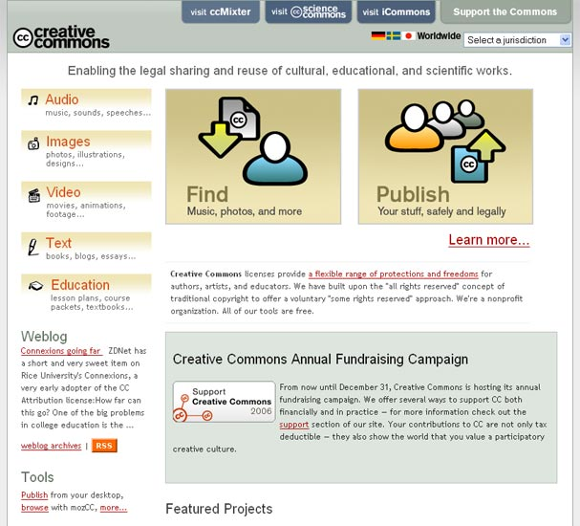
Plone
www.creativecommons.org

Slide 18
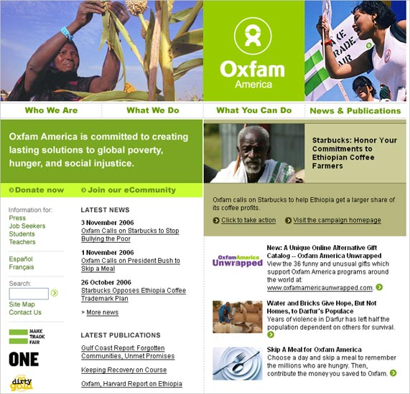
Plone
www.oxfamamerica.org

Slide 19
Joomla

Slide 20
Drupal

Slide 21
Plone

Slide 22
Questions?

